Slide 1
Early Childhood ECO/IEP Training
Idaho State Department of Education
2013

Slide 2
Agenda
8:30 - 9:00 a.m. Introductions, Agenda, Review of the Day, Questions
9:00 - 10:00 a.m. I DO
Screening Material/Transition Material
Parent Material
Observation Material
Professional Assessments/Arena or Team Assessment
Anchor Assessment
Eligibility Report
Early Childhood IEP 3 Outcome Areas: PLOPs and Annual Goals
10:00 – 10:15 a.m. Break
10:15 – Noon We DO
Packet with Student Information
Blank Early Childhood Form
Noon – 1:30 p.m. Lunch
1:30 – 4:00 p.m. You Do
Packet with Student Information
Blank Early Childhood Form
4:00 – 4:30 p.m. Report out

Slide 3
Objectives
Identify information needed to complete the New Early Childhood IEP
Practice

Slide 4
Collecting and Summarizing Evidence
Utilize all sources of current evidence (observation, interview, formal and informal assessments) and across time (pre-referral, transition, screening, evaluation).
Identify meaningful and useful behaviors and skills that show how child functions related to the outcome.
Focus on priority strengths and needs/concerns related to each outcome for the individual child.

Slide 5
Collecting and Summarizing Evidence
Refer to resource documents for:
Child development
Content covered in each outcome.
Keep a focus on what most children do with regard to the specific outcome.
Focus on concrete, discrete, and objective descriptions of the skill or behavior.
Avoid statements that are subjective, non- skill specific and vague (“loves”, “enjoys”, “good language skills”, “appears to”).

Slide 6
Collecting and Summarizing Evidence
Consider level of consistency and independence with which child demonstrates all elements of skill.
Words like “usually” and “sometimes” infer child does not use skill across all settings and situation or skill is not fully mastered.
Remember,
identify priority functional skills
enable involvement and progress in general education

Slide 7
I DO - Example
Identify what to collect
Pre-referral and/or Screening information
Infant Toddler Program assessments, case notes, etc.
Parent Interview/Questionnaires
Teacher Observation and student information
Anchor Assessment
Eligibility Assessments/Report

Slide 8
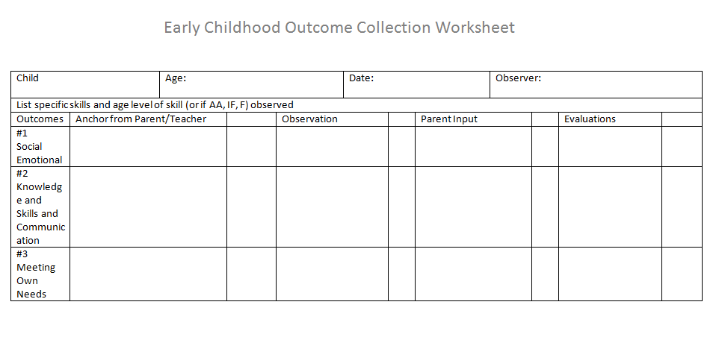
I Do - Example

Slide 9
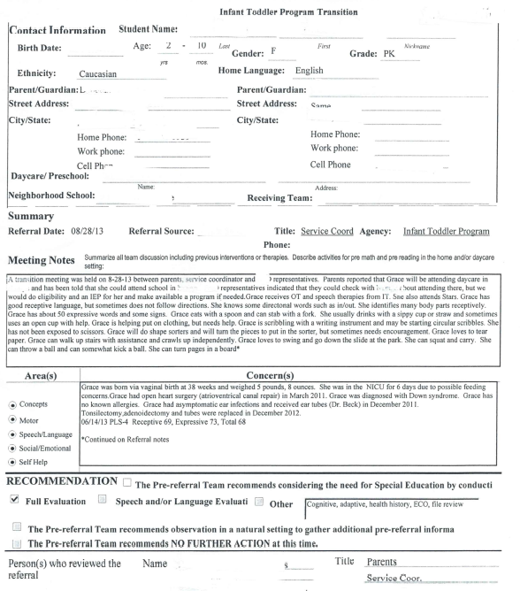
Pre-referral information from the Infant Toddler Program

Slide 10
Pulling out useful information

Slide 11
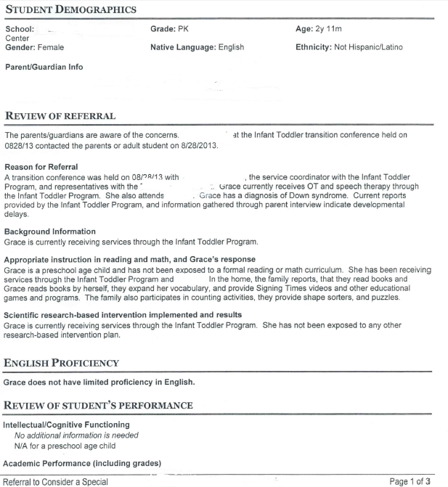
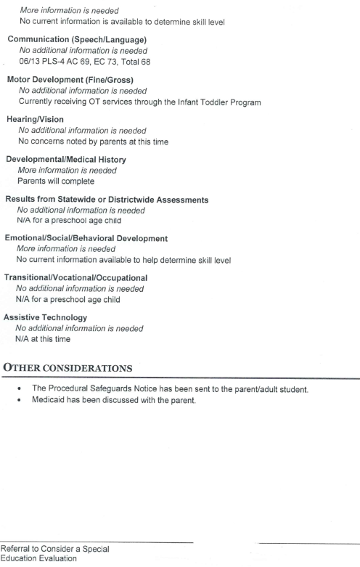

Slide 12
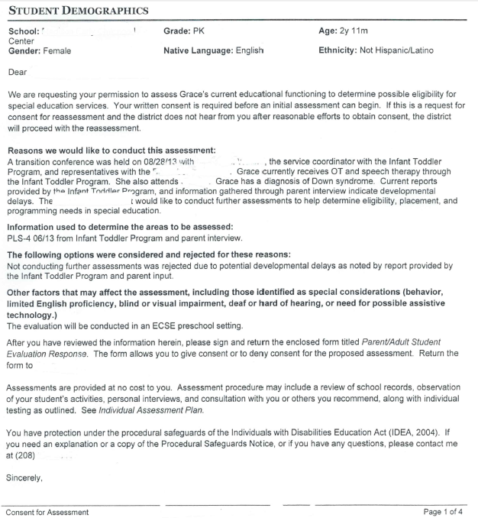
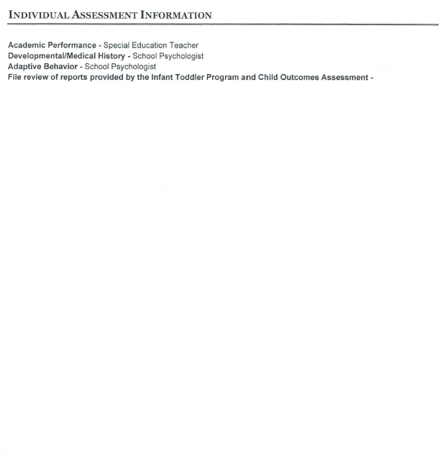

Slide 13
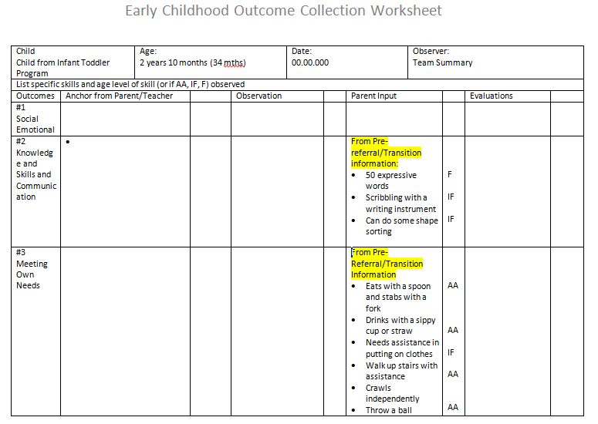
Data Summary

Slide 14
Parent Information

Slide 15
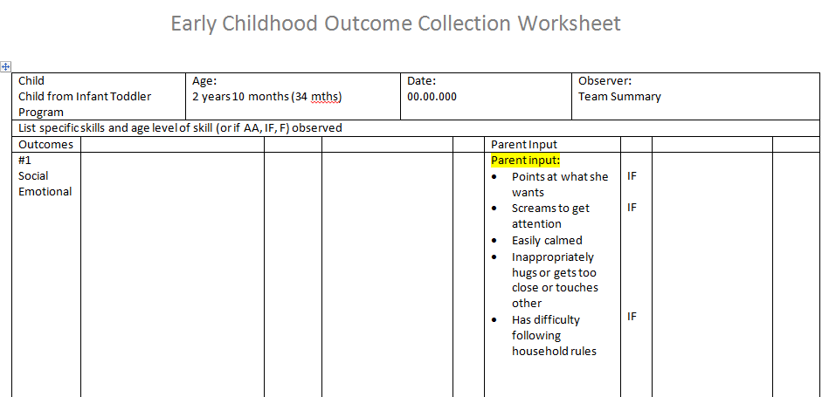
Data Summary

Slide 17
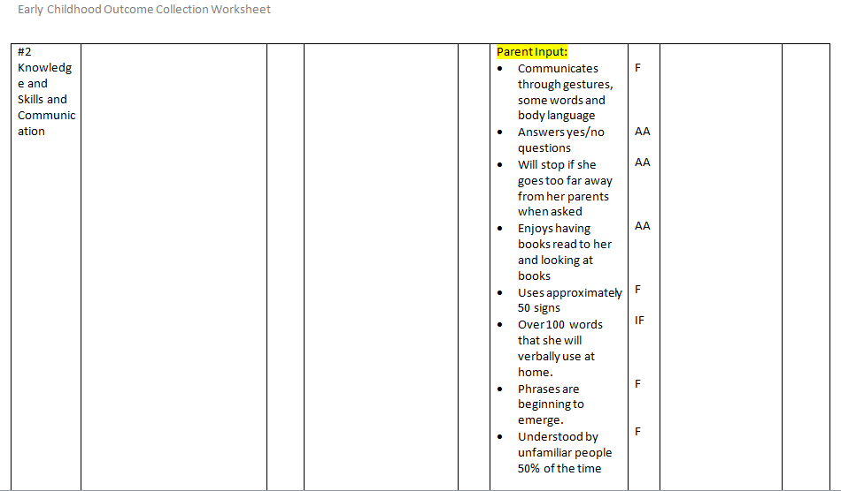
Data Summary

Slide 18
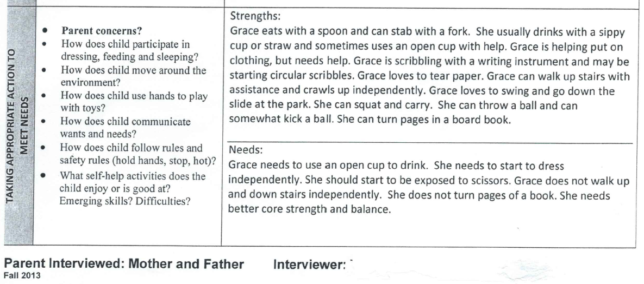

Slide 19
Data Summary

Slide 20
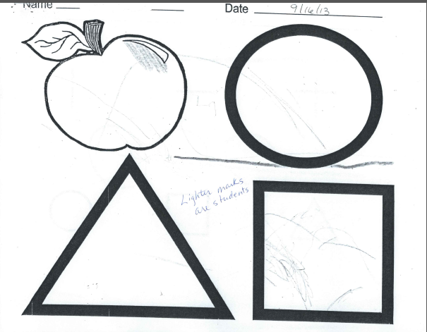
Teacher Observational/Student Information

Slide 21
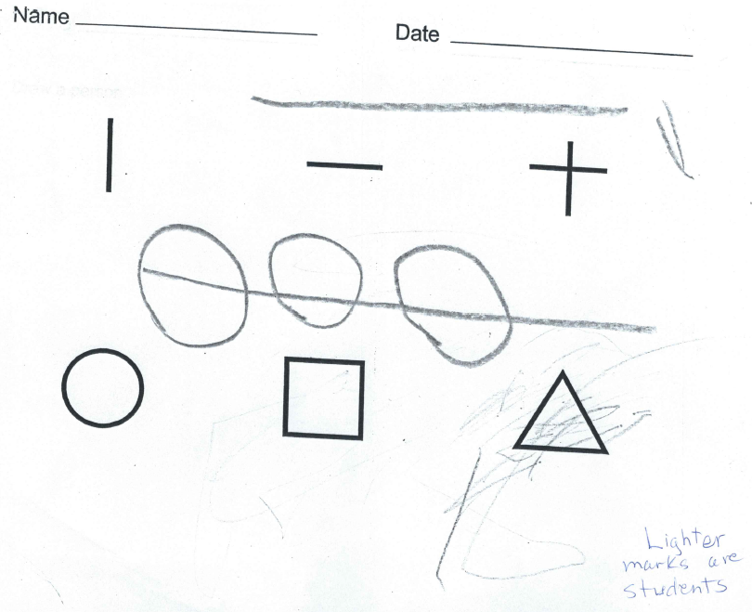

Slide 22
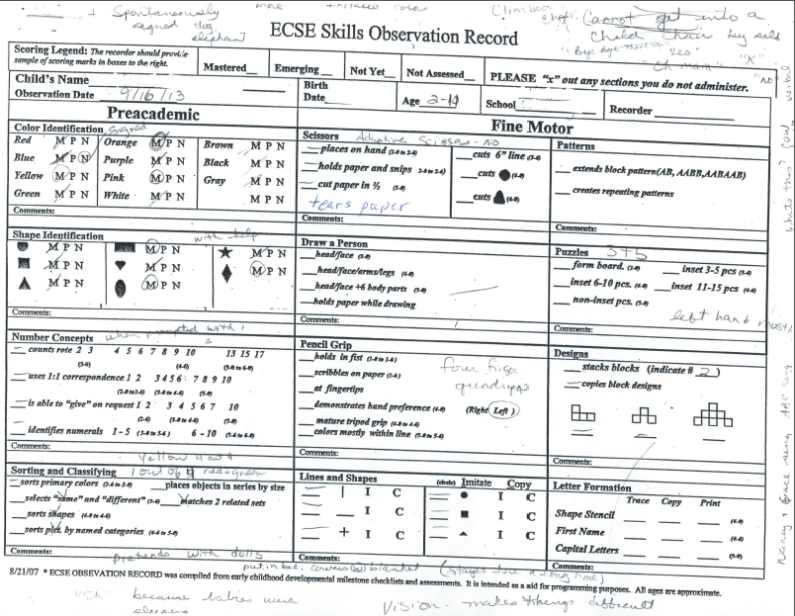

Slide 23
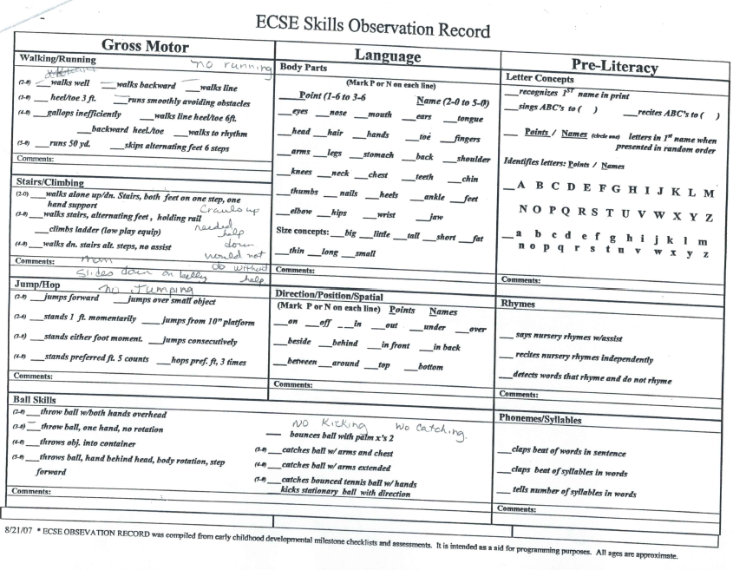

Slide 24
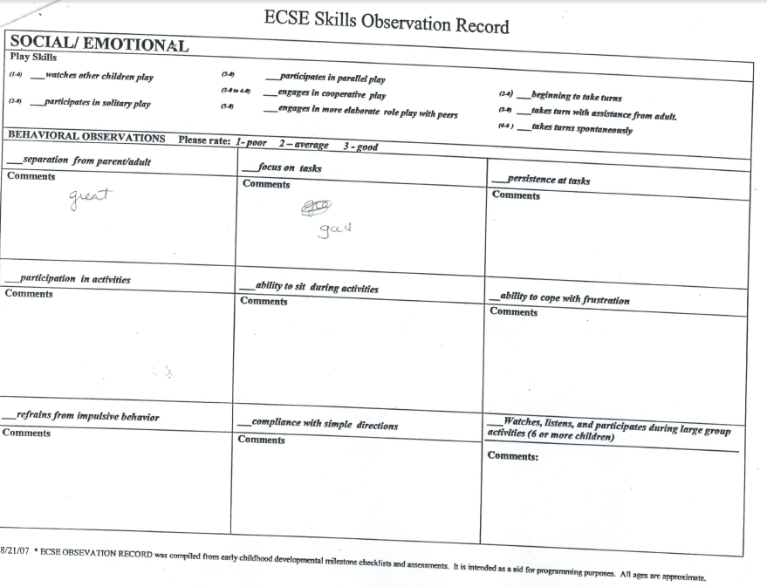

Slide 25
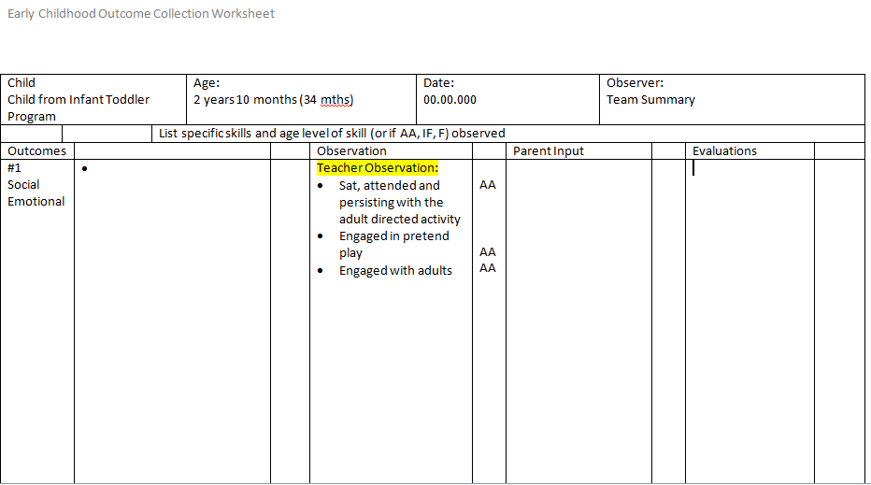
Data Summary

Slide 26
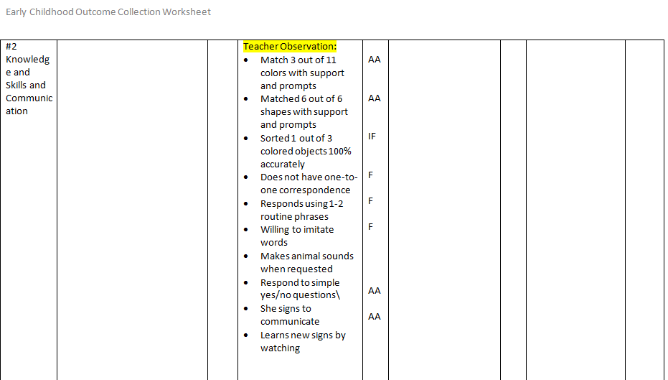
Data Summary

Slide 27
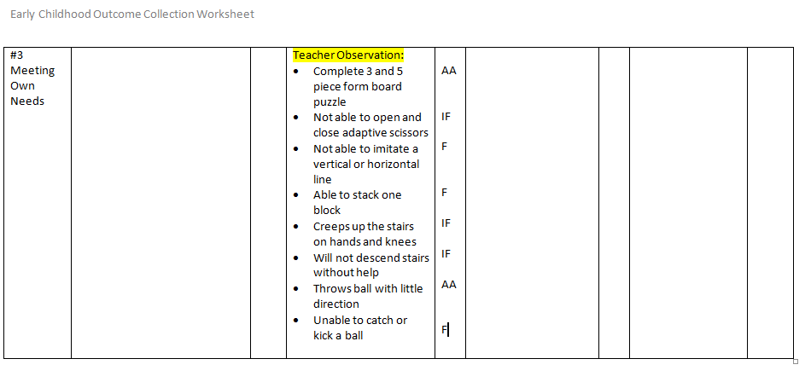
Data Summary

Slide 28
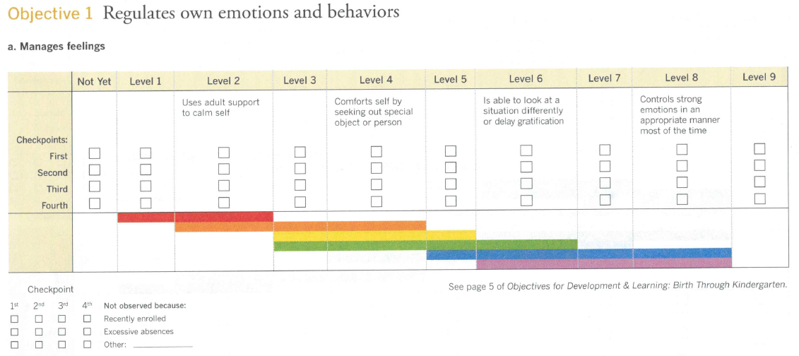
Anchor Assessment Teaching Strategies Gold
Red
Birth to 1 yeas of age
Orange
1-2 yeas of age
Yellow
2-3 years of age
Green Pre-K
3
Blue
Pre-K
4
Purple - Kindergarten

Slide 29
Parent and Teacher Responses
Teacher Response IF
Parent Response
AA

Slide 30
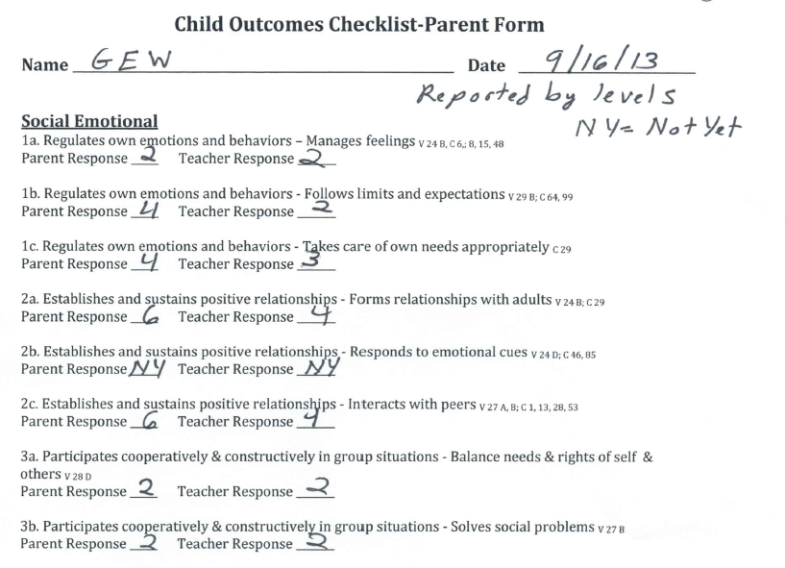
Teaching Strategies Summary from Teacher and Parent

Slide 31
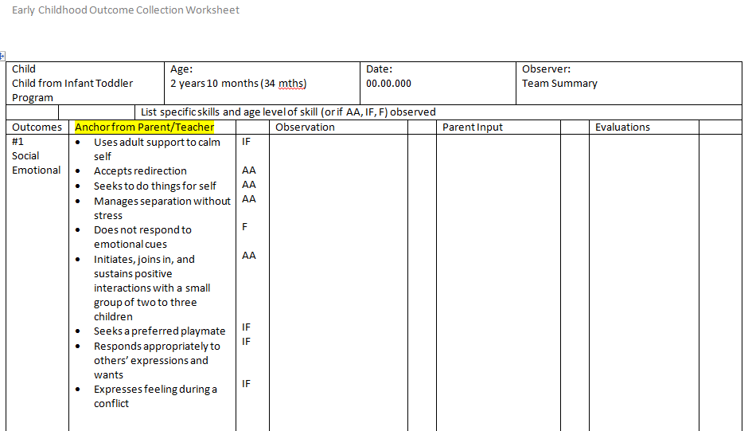
Data Summary

Slide 32
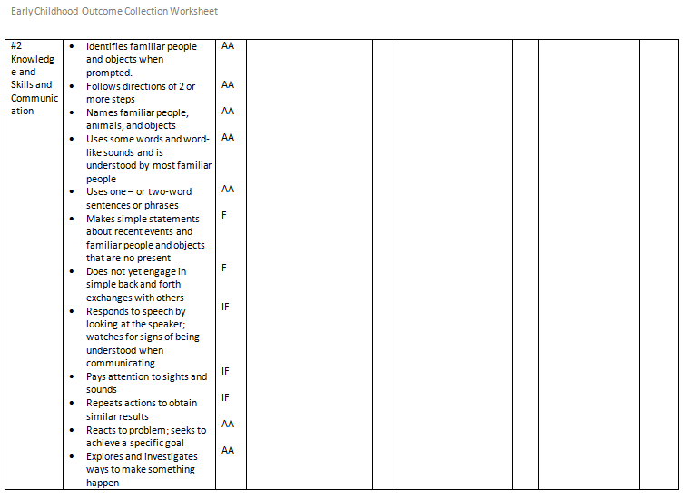
Data Summary
Additional Data was reported

Slide 33
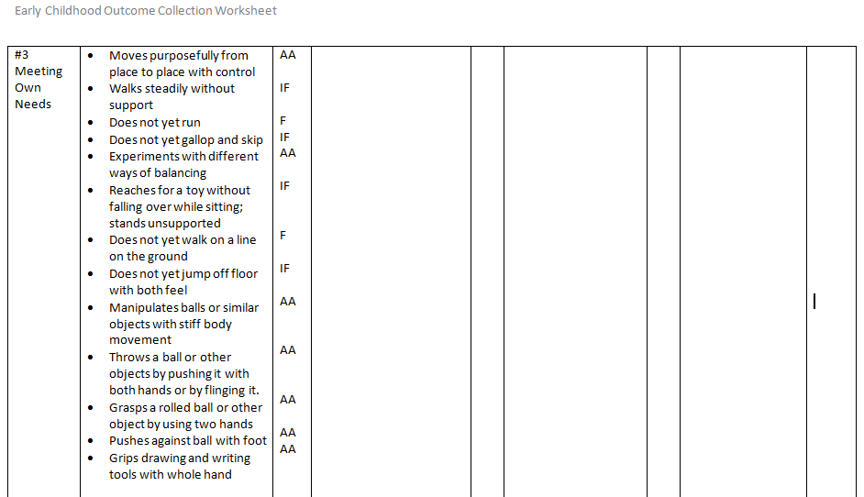
Data Summary

Slide 34
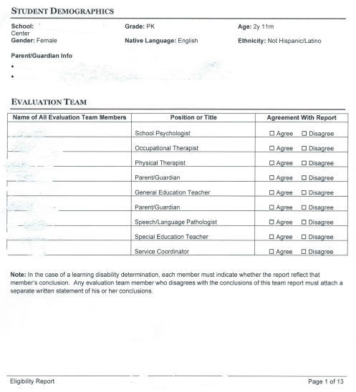
Eligibility Report

Slide 35
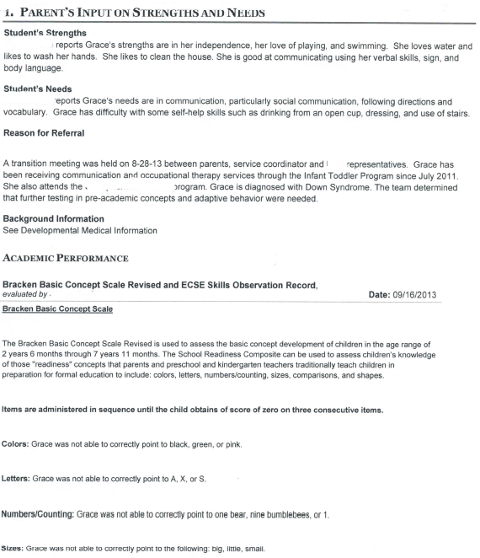

Slide 36
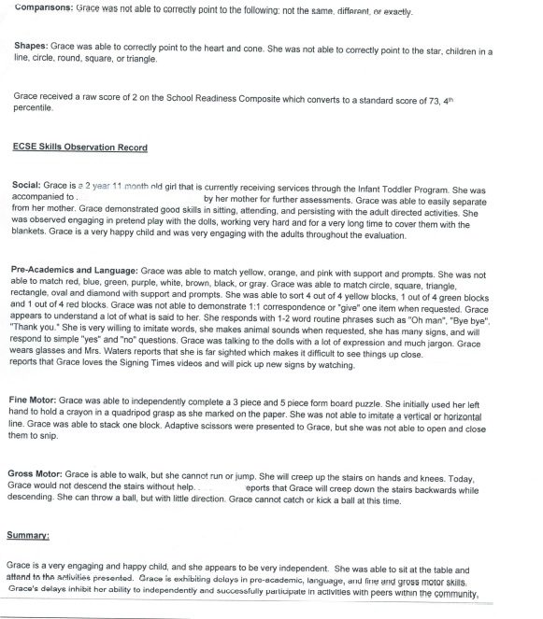

Slide 37
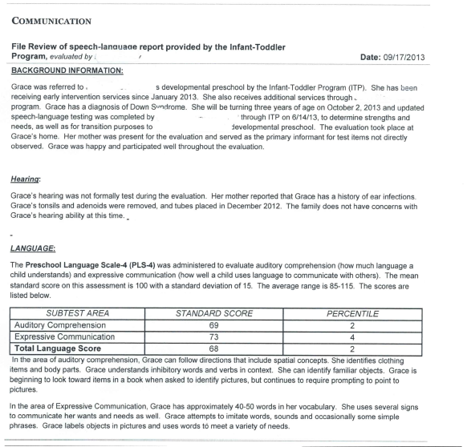

Slide 38
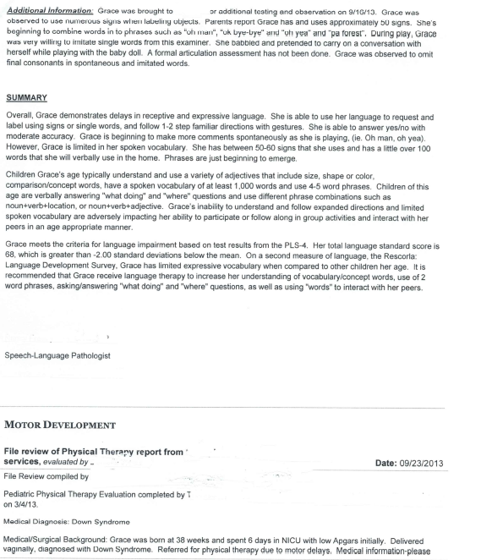

Slide 39
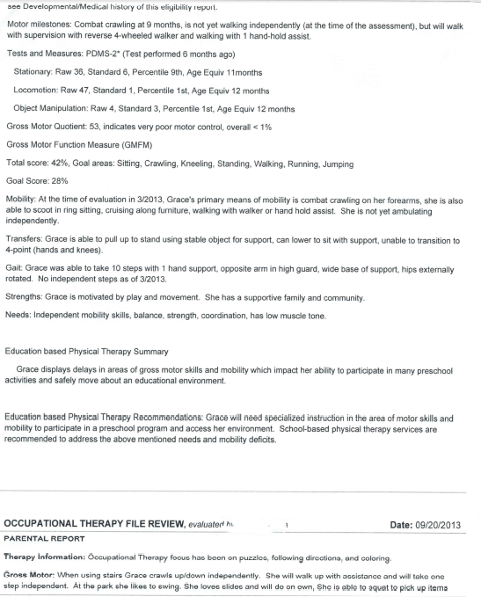

Slide 40
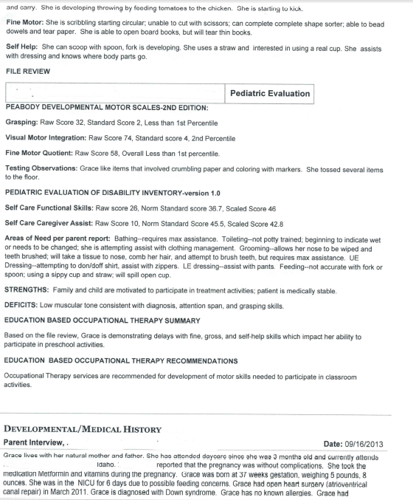

Slide 41
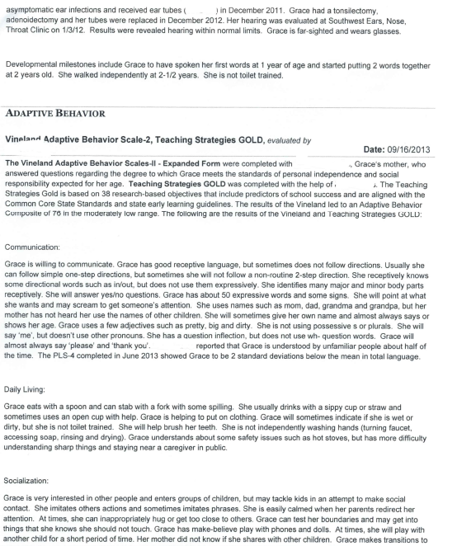

Slide 42
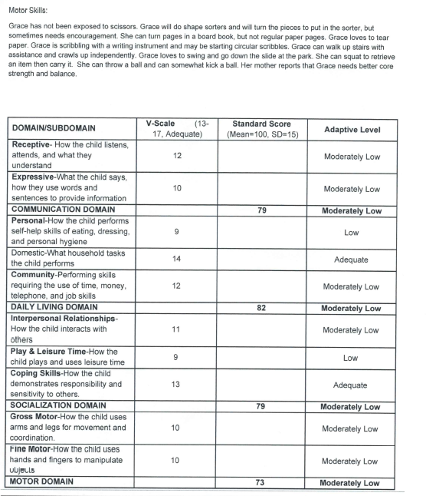

Slide 43
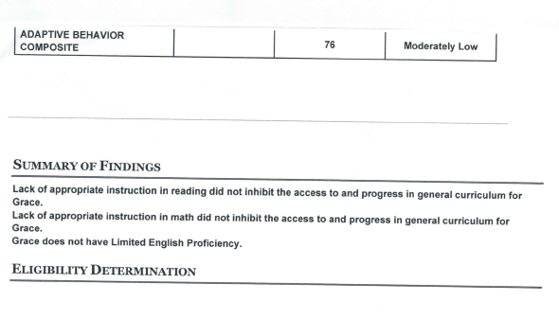

Slide 44
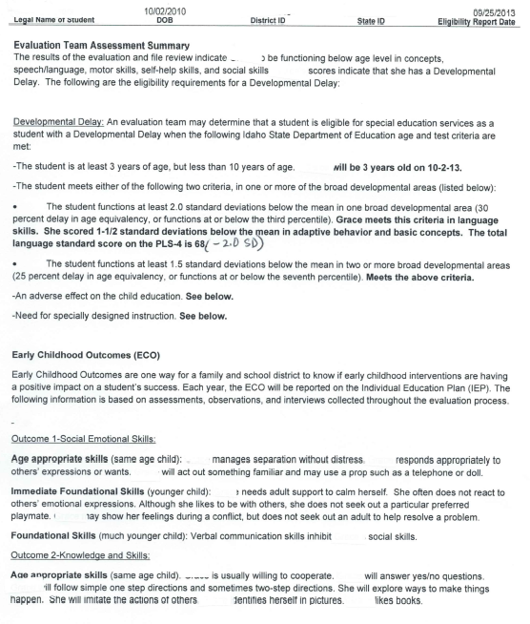

Slide 45
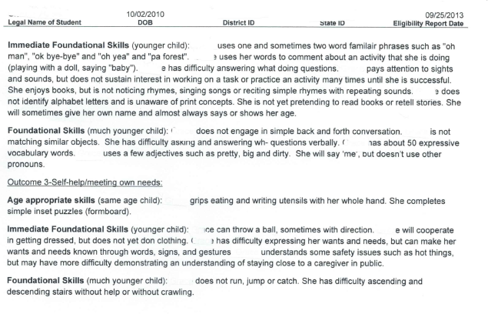

Slide 46
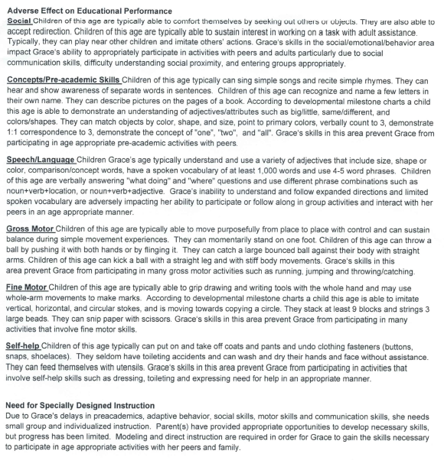

Slide 47
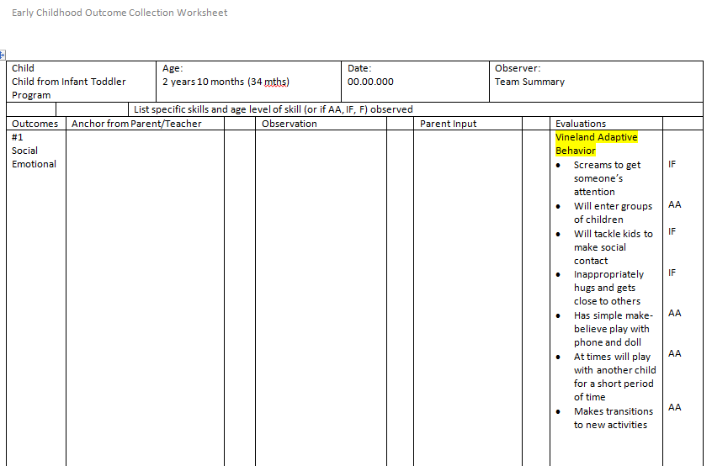
Data Summary

Slide 48
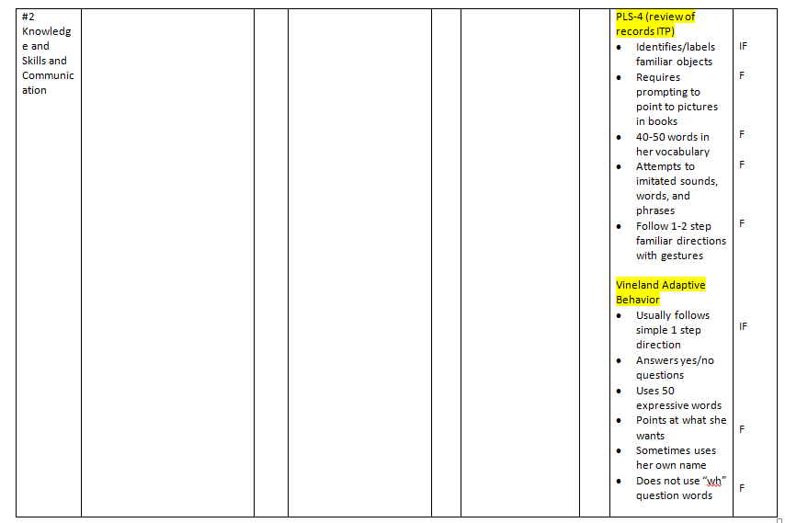
Data Summary

Slide 49
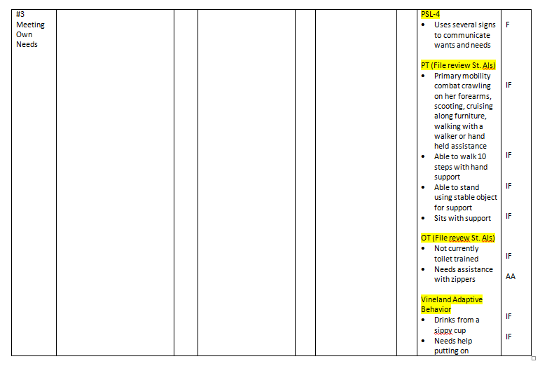
Data Summary

Slide 50
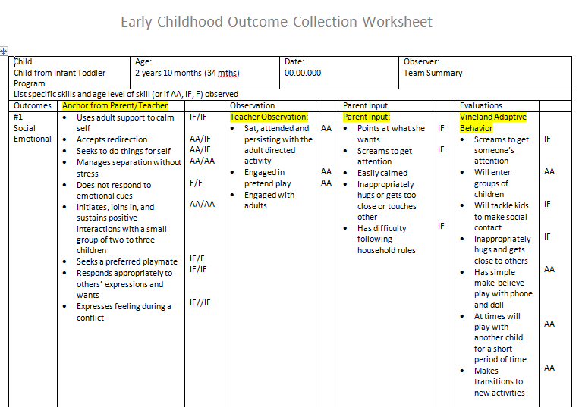
Accumulation of the Complete Summary

Slide 51
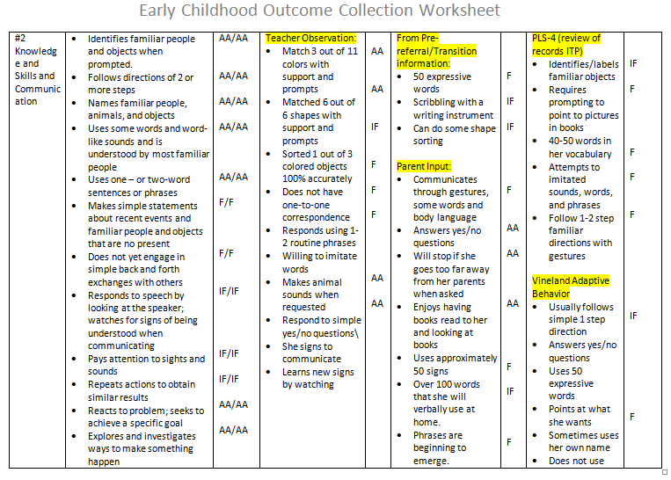

Slide 52
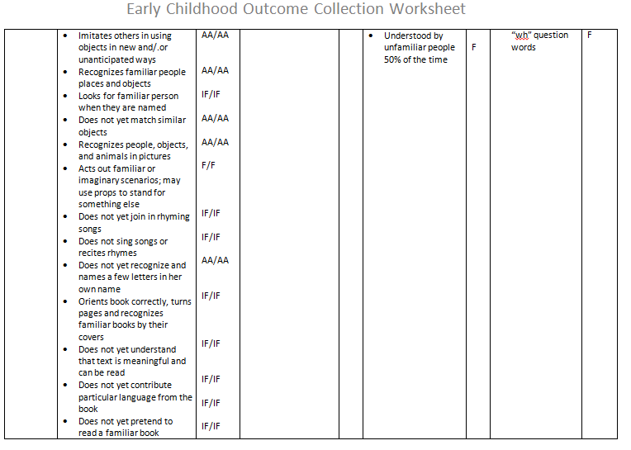

Slide 53
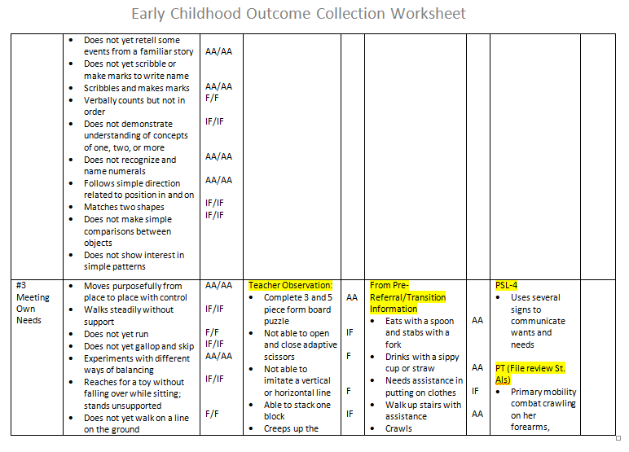

Slide 54
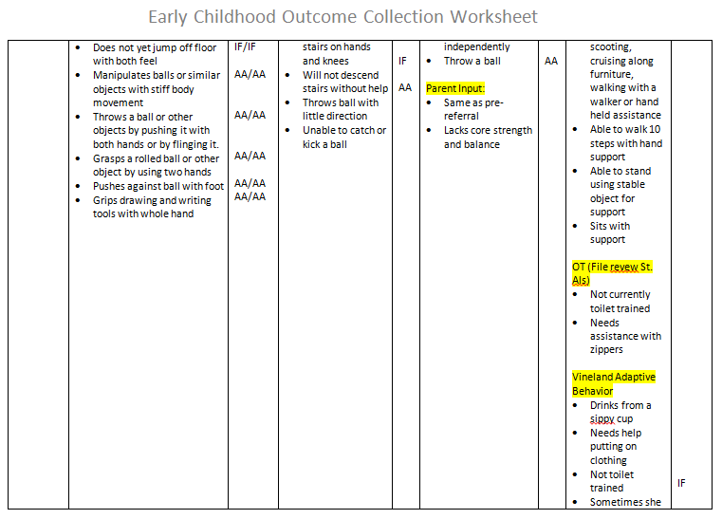

Slide 55
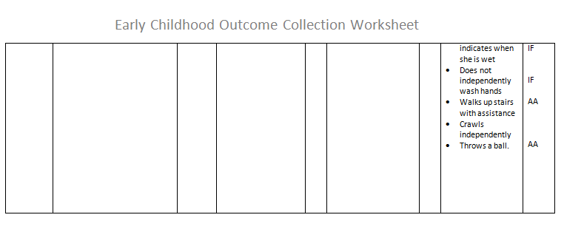

Slide 56
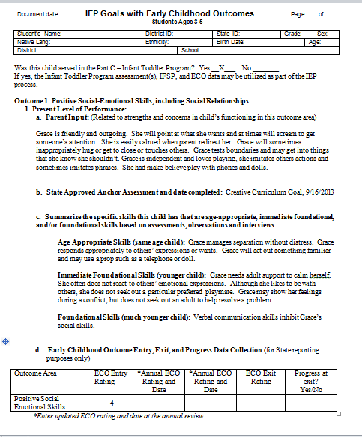
Pre-referral information, Child Outcomes Parent Interview, and Eligibility report.
Pre-referral information, teacher observation, parent interview, anchor assessment, eligibility, etc.

Slide 57
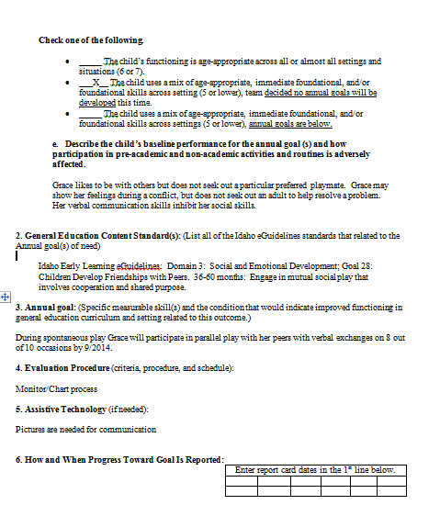
Baseline from observation and parent input
eGuidelines
Goal that matches baseline

Slide 58
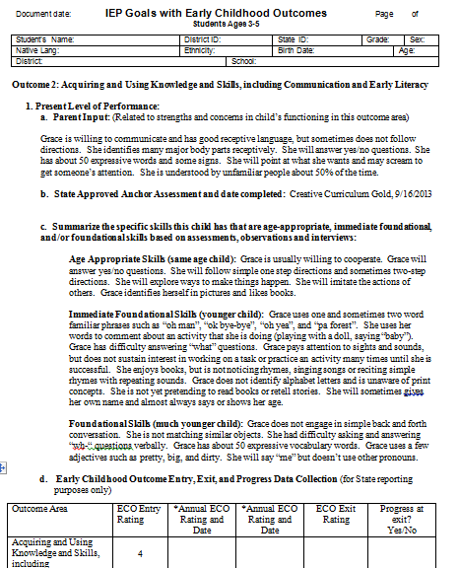
Pre-referral information, Child Outcomes Parent Interview, and Eligibility report.
Pre-referral information, teacher observation, parent interview, anchor assessment, eligibility, etc.

Slide 59
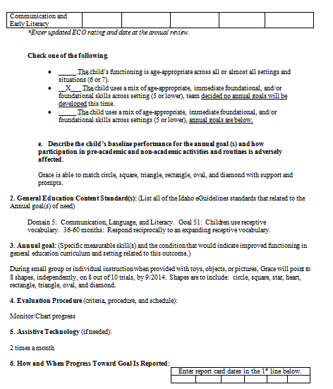
1st Baseline
1st eGuideline
1st Goal aligned to baseline

Slide 60
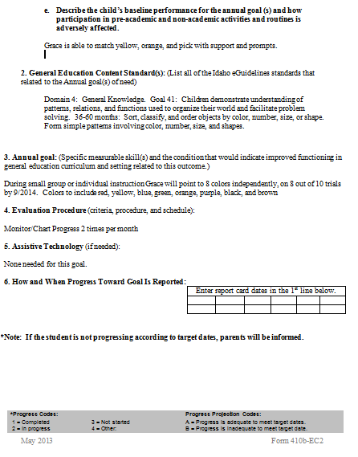
2nd Baseline
2nd eGuidelines
2nd Goal aligned to baseline

Slide 61
3rd Baseline
3rd eGuidelines
3rd Goal aligned to baseline

Slide 62
Pre-referral information, Child Outcomes Parent Interview, and Eligibility report.
Pre-referral information, teacher observation, parent interview, anchor assessment, eligibility, etc.

Slide 63
Baseline from observation and OT evaluation
eGuidelines
Goal that matches baseline

Slide 64
We Do – Example
What do you have available?
Pre-referral and/or Screening information
Infant Toddler Program assessments, case notes, etc.
Parent Interview/Questionnaires
Teacher Observation and student information
Anchor Assessment
Eligibility Assessments/Report

Slide 65
Notes:
Structured and Guided Practice is a phase of direct instruction where the teacher leads the student through practice of each step in order to reduce errors in the initial learning process. Immediate feedback is critical. If you get to the I do stage and see there is more need for practice you return to we do activates.

Slide 66
“We Do” – Structured or Guided Practice Activity
Step 1: Review all available sources of data
Step 2: Collect information on specific skills related to each outcome (Optional - ECO Collection Worksheet)
Step 3: Assign AA, IF, F to skills
Step 4: Write PLOP (Parent input, Anchor assessment, Specific skills by AA, IF, F and ECO rating)
STEP 5: Write Annual Goals (Baseline, Standards)
We will debrief between steps
Notes:
**** We will all be doing the same file for the We Do activity
Structured Practice is a phase of direct instruction where the teacher leads the student through practice of each step in order to reduce errors in the initial learning process. Immediate feedback is critical. If you get to the I do stage and see there is more need for practice you return to we do activities.
Guided Practice is when the teacher reduces the support and students begin to apply the steps independently, but the teacher monitors as they work
Independently or in groups. Visual tools can be used to remind students of the steps.
I think we will do a mix of the two. Take ___ minutes to do step 1-3, then we will debrief before moving on to step 4 and 5
Questions?

Slide 67
“You Do” Independent Practice Activity (Choose a case study file or use your file)
Step 1: Review all available sources of data
Step 2: Collect information on specific skills related to each outcome (Optional - ECO Collection Worksheet)
Step 3: Assign AA, IF, F to skills
Step 4: Write PLOP (Parent input, Anchor assessment, Specific skills by AA, IF, F and ECO rating)
STEP 5: Write Annual Goals (Baseline, Standards)
Notes:
This is when the student demonstrates knowledge of concept without teacher assistance. Teacher may provide additional guided practice as needed. Feedback is given but may be delayed. Practice is to help build fluency of being able to do the skill.
So we will provide guidance as needed.

